Slide 1
Reinsurance Portfolio Optimizer
Samuel Treadway

Slide 2
Reinsurance Portfolio Optimizer Details
Allocates reinsurance coverage across various risk categories to:
Minimize expected losses
Stay within budget
Meet regulatory capital requirements
Maximize coverage efficiency
Useful for:
A risk manager at an insurance firm
An actuarial team evaluating reinsurance strategies

Slide 3
Why is this optimizer valuable?
Returns a minimized net loss dollar amount after purchasing reinsurance
Helps risk managers and actuaries justify decisions with quantitative evidence
Can be integrated with financial planning tools or regulatory compliance dashboards

Slide 4
High Level Model Details
Objective
Minimize the total expected net loss after purchasing reinsurance
Decision variables
Coverage amount purchased from each contract for each risk
Constraints
Budget constraint
Total cost of purchased coverage must not exceed specified budget limit (I used $300,000)
Capital retention constraint
Total retained loss must not exceed specified limit (I used $200,000)

Slide 5
High Level Simulated Data Description
Risk categories: flood, fire, auto
Reinsurance contracts: Contract A, Contract B, Contract C
Expected losses per risk category: flood ($100,000), fire ($80,000), auto ($60,000)
Total expected loss before insurance: $240,000
Recovery rate: 40-60%, randomized
Proportion of loss covered by each contract for each risk
Price per unit of coverage for each contract and risk: $1-$3, randomized
Maximum coverage allowed by each contract for each risk: $20,000 - $50,000, randomized
Total budget for purchasing reinsurance: $300,000
Maximum allowable retained loss after reinsurance: $200,000

Slide 6
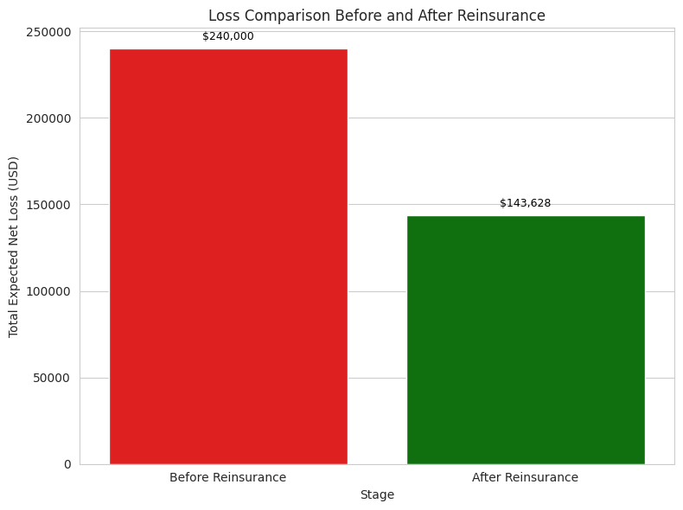
Loss Comparison Before/After Reinsurance

Slide 7
Ideas for Next Steps
Update constraints to reflect specific business needs
Integrate real data into the model
Connect it to databases or even APIs
Create a UI that accepts user inputs and exports reports

